Slide 1

Nutrition Analysis
(Part-1 of Bachelor Thesis Project)
Presented By
Gaurav Shresth
20BT10018
Kshamit Bombarde
20BT3AI07
Under the Guidance of
Prof. Neeraj Kumar Goyal
Subir Chowdhury School of Quality and Reliability

Slide 2
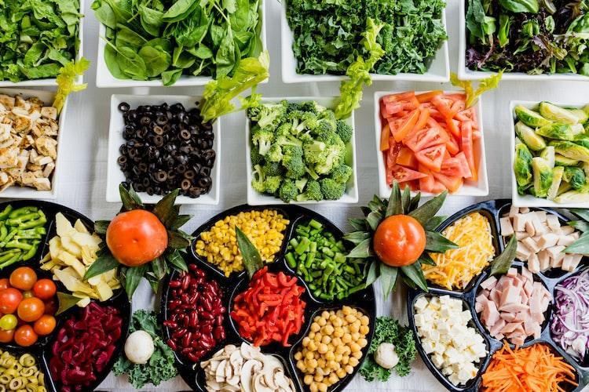
Nutrient Exploration: A Data Analysis Perspective on Food
This project involves leveraging data analytics techniques to deep into a comprehensive dataset compressing of diverse foods and their nutritional profiles. The analysis means to uncover examples, relationships, and bits of knowledge inside the wholesome scene through efficient information cleaning and exploratory investigation. By ordering food varieties in light of their supplement pieces and utilizing perception devices, the venture looks to offer a nuanced comprehension of dietary patterns and distinguish food varieties with unmistakable wholesome qualities. A definitive objective is to give important experiences to illuminate dietary decisions, support wellbeing cognizant independent direction, and add to more extensive conversations on sustenance and prosperity.

Slide 3
What type of Problems we can solve
Nutrition analysis can address a variety of issues related to health, wellness, and dietary planning. Here are a few problems that can be addressed through nutrition analysis, along with some general figures related to men's caloric intake:
Nutrient Deficiency Prevention
Personalized Dietary Recommendations
Community Health Initiatives

Slide 4
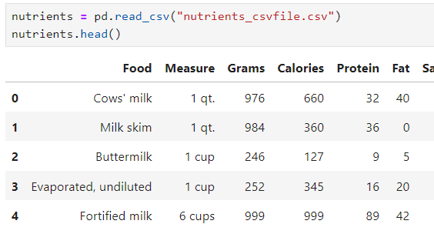
Dataset Overview
The dataset contains a csv file includes 333 rows and 10 column with string, integer and float values.
The data contain Food items with their calories, fat, protein and carbs intakes.

Slide 5
Data Cleaning
Data Type Conversion.
Addressing Data Integrity Issues.
Handling Irrelevant Data.
Handling Missing Data.
Dealing with Duplicates.
Creating Derived Variables.
Documentation.
Handling Outliers.
Standardizing Formats.
Correcting Inconsistencies.

Slide 6

Exploratory Data Analysis (EDA)
Through Exploratory Data Analysis (EDA), the data underscores that Fats & Oils exhibit the highest calorie intake per gram, emphasizing the significance of macronutrient awareness in dietary considerations.
Complementing this insight, the next slide incorporates visually impactful charts that elucidate the dominance of Fats & Oils in calorie density, facilitating a clear and accessible representation of the data for enhanced understanding and informed dietary decision-making.

Slide 7
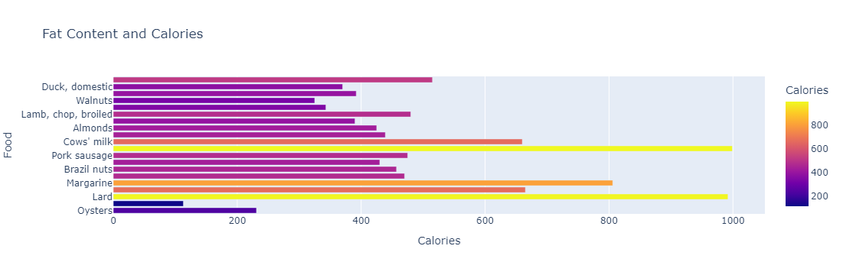
Foods to stay away from
Fortified milk has the most calories, followed by white bread. Also, notice how whole wheat has the most proteins but has almost equal amount of calories. Lard is fat source with most calories and 1/2 cup of ice-creams tops the charts in the dessert category.

Slide 8
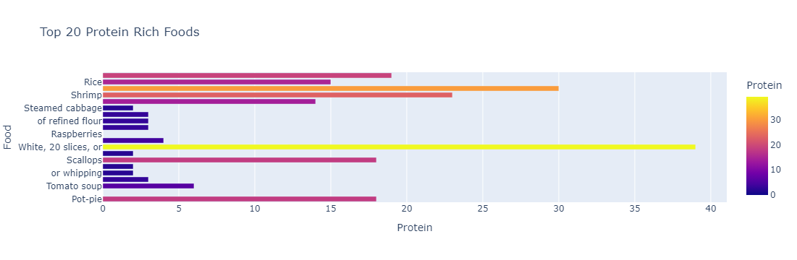
Best foods for protein Intake
When focusing on protein-rich options, slices and rice stand out as exemplary sources, emphasizing their potential role as optimal protein providers. Shifting the focus to fats, Lard takes the lead as the highest-calorie fat source. These findings, supported by illustrative charts, contribute to a nuanced understanding of nutritional choices, facilitating informed decisions for a balanced and well-rounded diet.

Slide 9
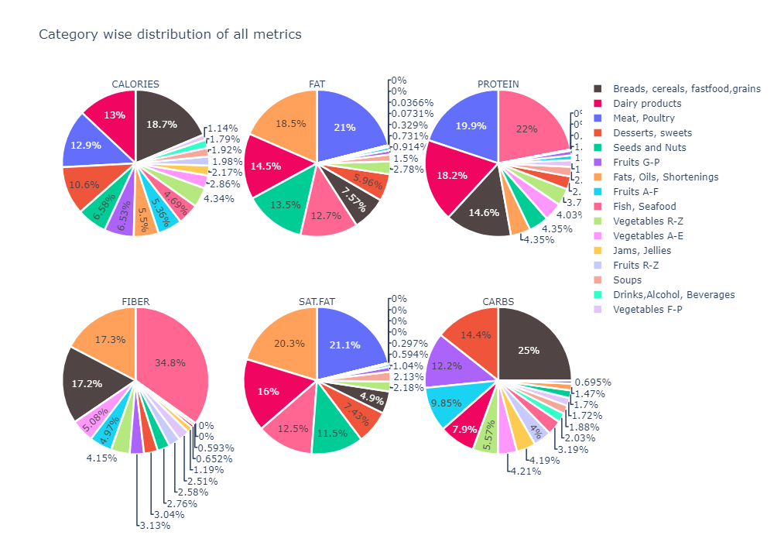

Slide 10

Conclusion
In conclusion, this project on food nutrition analysis through Exploratory Data Analysis (EDA) has provided valuable insights into the dietary landscape, showcasing the significance of considering macronutrients and their impact on calorie density. Notably, Fats & Oils emerged as the highest-calorie contributors, emphasizing the importance of macronutrient awareness in making informed dietary choices.
Moreover, the project shed light on intriguing findings, such as fortified milk and white bread topping the calorie charts, and the observation that whole wheat, while rich in proteins, maintains a comparable calorie level. These nuanced revelations underscore the multifaceted nature of nutritional considerations and the need for a holistic approach to dietary planning
For future work, the integration of fuzzy logic algorithms, as well as potential exploration into machine learning, time series analysis, geospatial analysis, and other advanced methodologies, holds promise for a more comprehensive understanding of dietary patterns. The versatility of these approaches can further refine the accuracy of predictions, accommodate uncertainty, and unveil intricate relationships within the dataset.

Slide 11
Future Work
For Handling Uncertainty, we are trying to use the Fuzzy logic. It is well-suited for dealing with uncertainty and imprecision in data. It allows for the representation of vague or ambiguous information, which is common in real-world datasets.
Enhance the dataset by integrating external databases or APIs that provide additional information, such as nutritional databases, food safety information, or health databases. By using this we can create a software, that can analyze the calorie intake for a person and give a statutory warning according to their Health conditions.
Implement advanced machine learning models to predict nutritional trends, classify food categories, or provide personalized dietary recommendations. Algorithms like regression, decision trees, and neural networks can be explored.

Slide 12
References
National Health Government Website https://www.nutrition.gov/
MATLAB. (2023). "MATLAB Fuzzy Logic Toolbox Documentation." MathWorks. https://matlab.mathworks.com/
British Nutrition Foundation https://www.nutrition.org.uk/
Jupyter Notebook for Data Analysis https://jupyter.org/
Kaggle for Dataset and Libraries https://www.kaggle.com/
ChatGPT for content references https://chat.openai.com/

Slide 13
Thank you. Please feel free to ask any questions. 😄

